Slide 1
BIG DATA Climate Change
Julie Yang

Slide 2
Table of contents
1
2
3
What is the
climate change?
Data and predictions
Challenges and conclusion
Long-term shifts in temperatures and weather patterns
Tweets from Aug 23 ~24 @ClimateChange
Array type data →S3
Word cloud

Slide 3
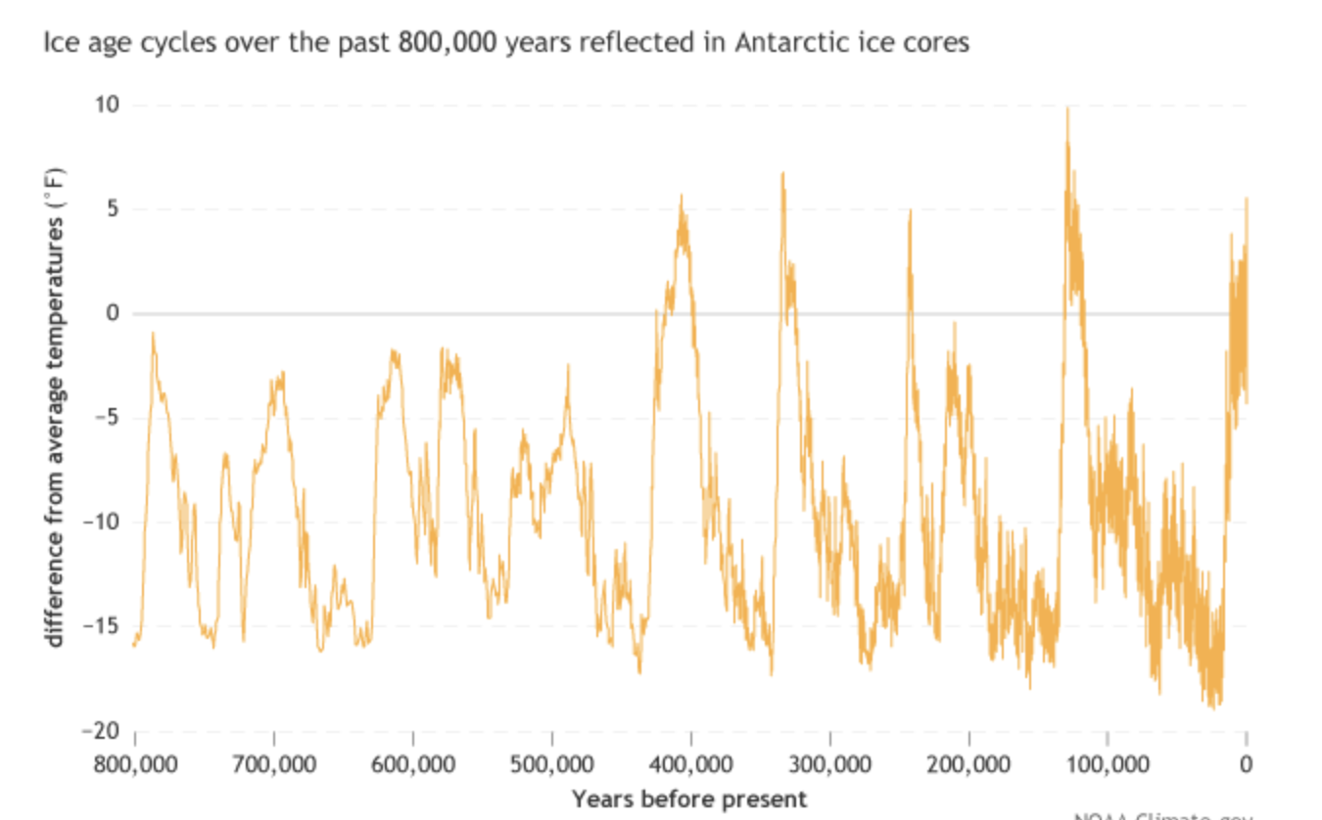
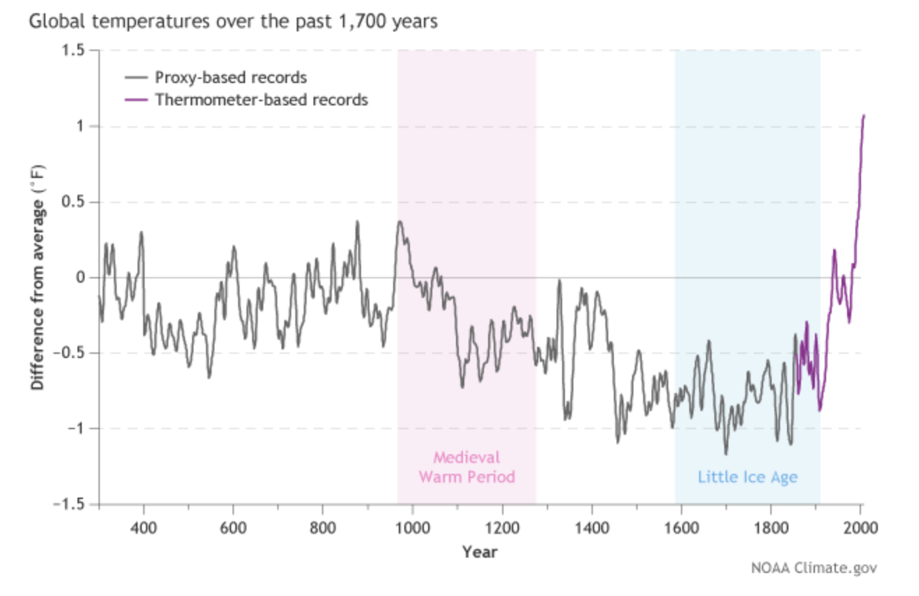
Is climate change real?
Waste
Deforestation
Breeding
Industry
Venus is the second planet from the Sun
Mars is actually a very cold planet
Jupiter is the biggest planet of them all

Slide 4
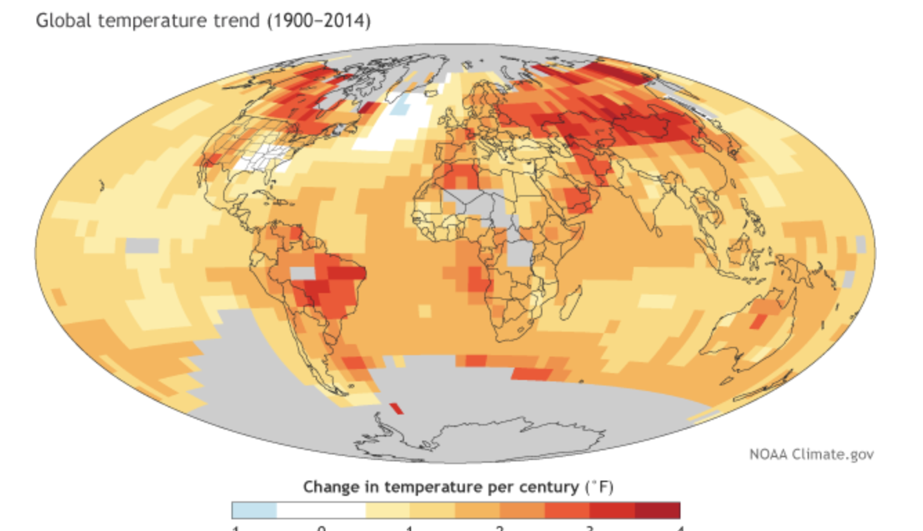
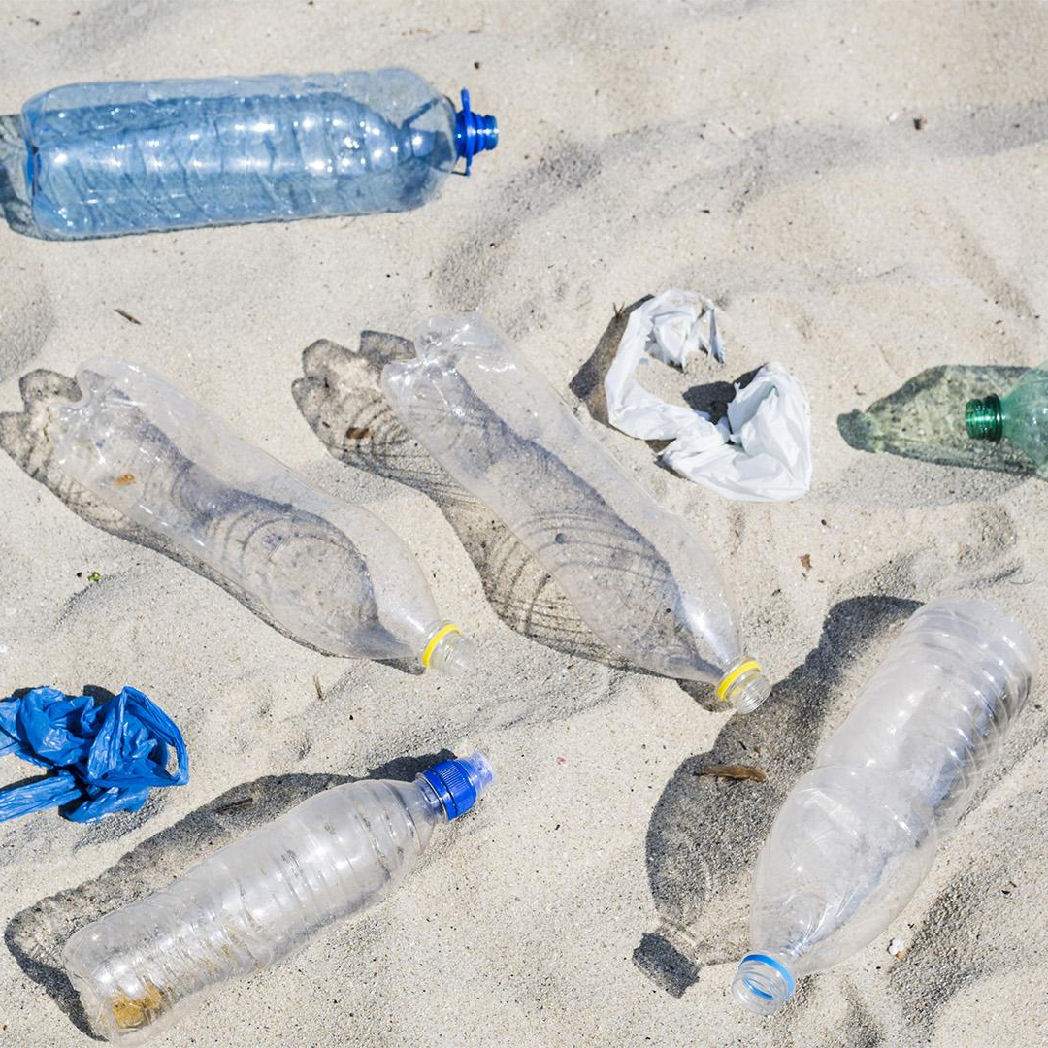
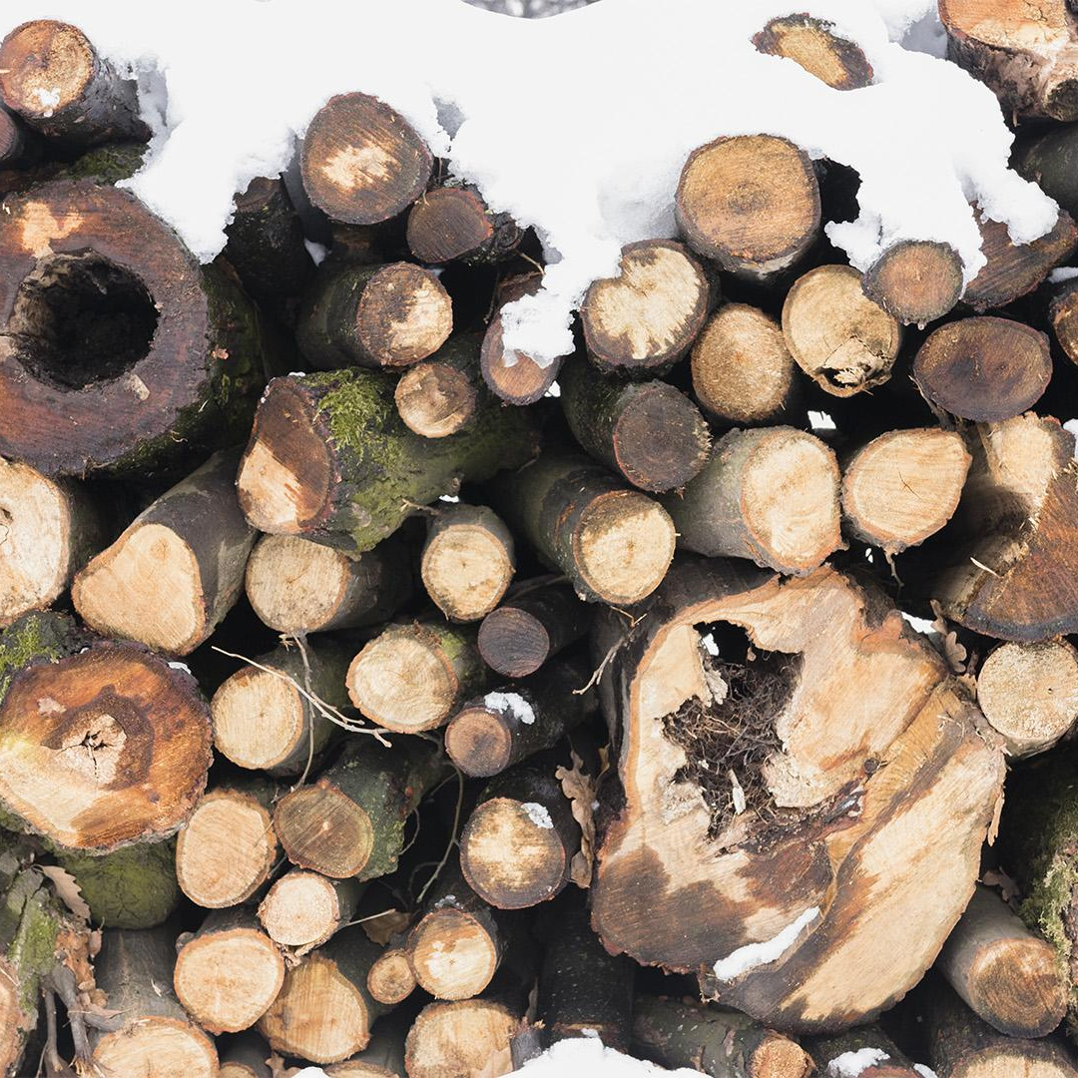
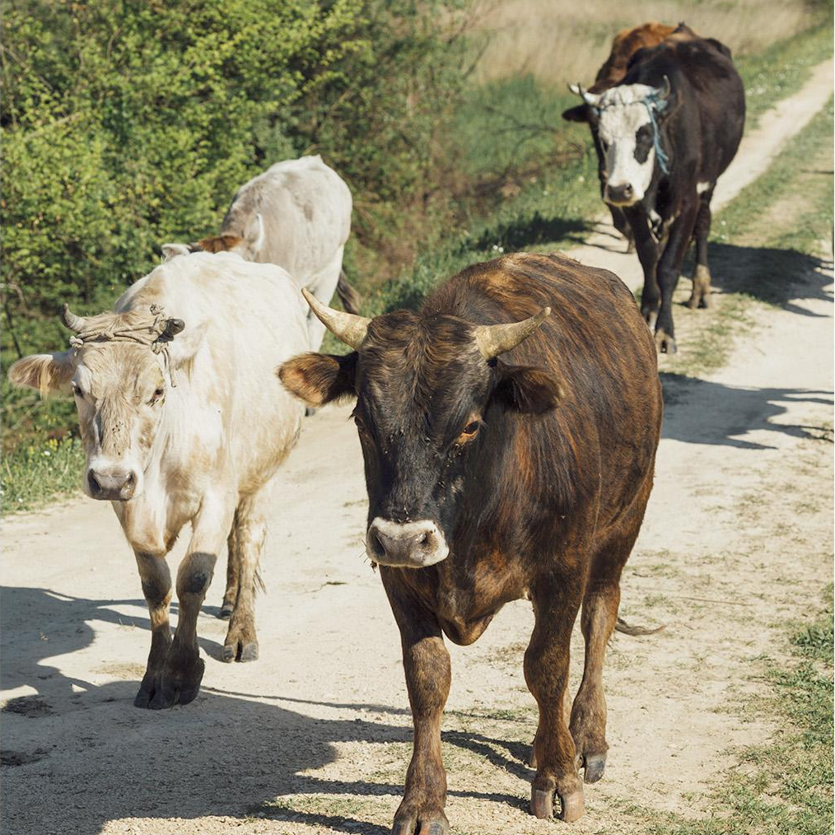

Rate of Temp change
Waste
Deforestation
Breeding
Industry
Venus is the second planet from the Sun
Mars is actually a very cold planet
Mercury is the smallest planet
Jupiter is the biggest planet of them all

Slide 5
Tweets @ClimateChange
Aug 23~24
69109

Slide 6
Data clean up
'tweet_id' | StringType()
'user_name' | StringType()
'user_id' | StringType()
'tweet' | StringType()
'followers' | IntegerType()
'Location' Time | StringType() StringType()
Notes:
'tweet_id', 'user_name', 'user_id', 'tweet', 'followers', 'location', 'geo', 'time'

Slide 7
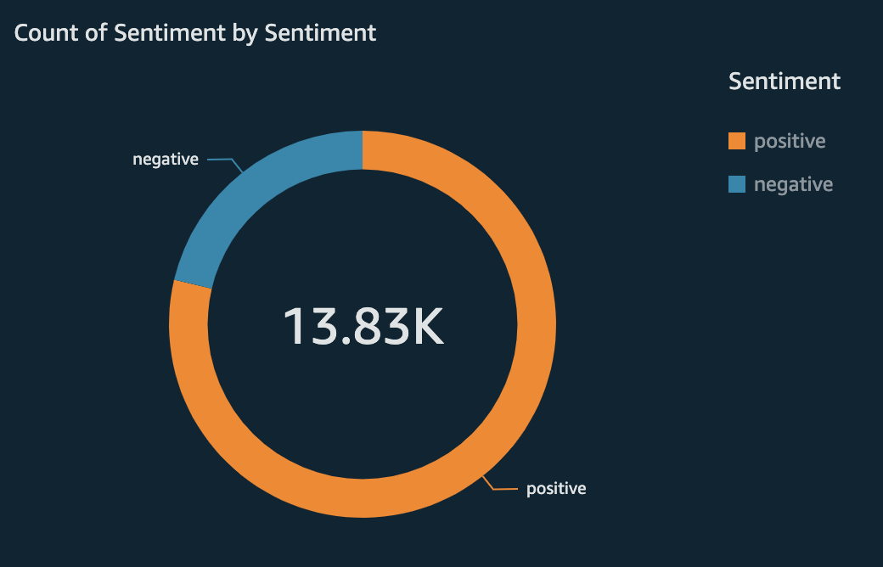
Sentiments
-22%
+78%
Negative views
Positive views

Slide 8
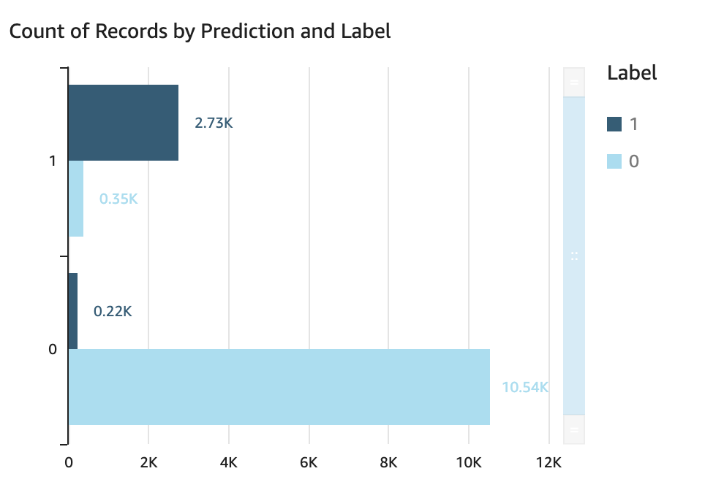
Predictions
Big numbers catch your audience’s attention
Notes:
86% →+96%

Slide 9
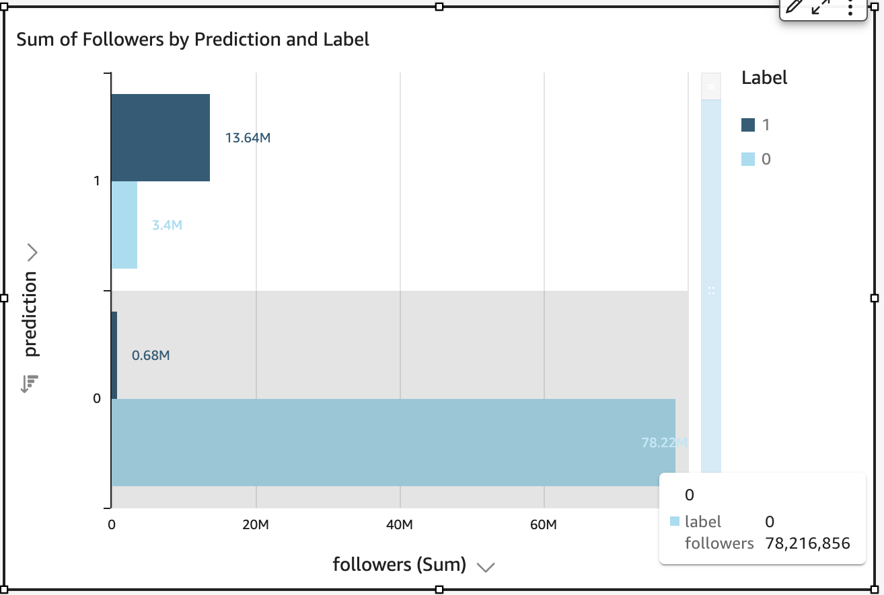
Predictions
Big numbers catch your audience’s attention
Notes:
86% →+90%

Slide 10
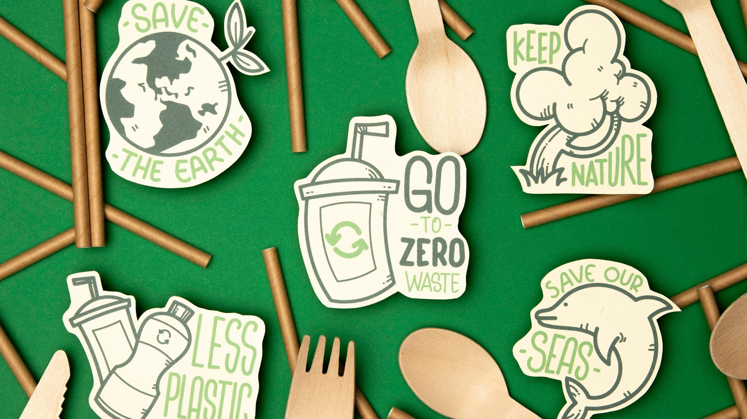
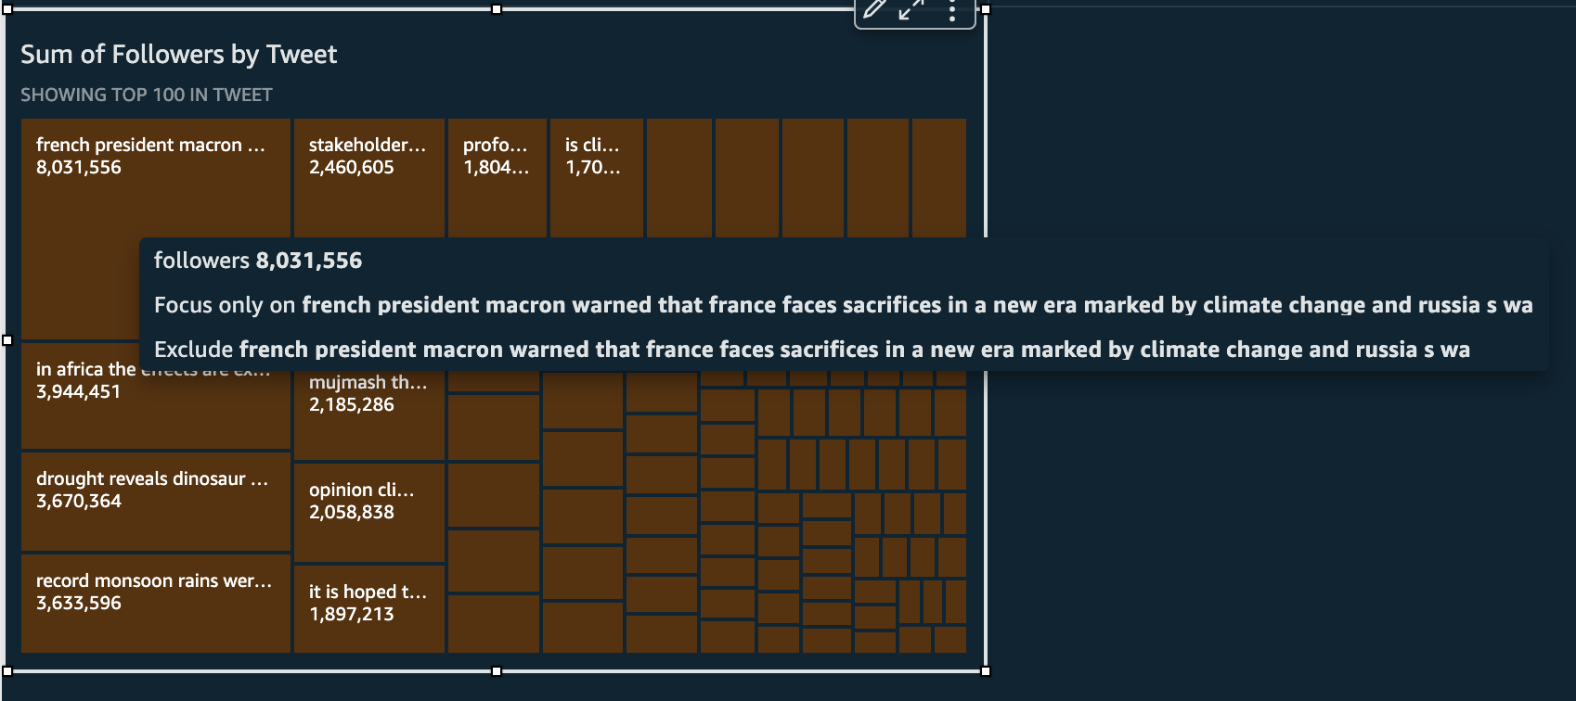
A picture is worth a thousand words!
Notes:
Tree map

Slide 11

A picture is worth a thousand words!

Slide 12
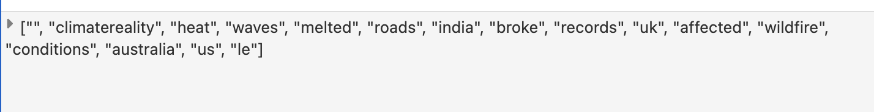
Challenges
Save array type data to S3
Word cloud
Notes:
Few features to work with…

Slide 13
Recommendations
Create more features
Make top 50 words for word cloud

Slide 14
The Stone Age didn't end for lack of stone, and the oil age will end long before the world runs out of oil.
Ahmed Zaki Yamani, Minister of Oil for Saudi Arabia
Notes:
The renewable energy era will be upon us sooner than we think.

